Slide 1
WINDOWS 11

Slide 2
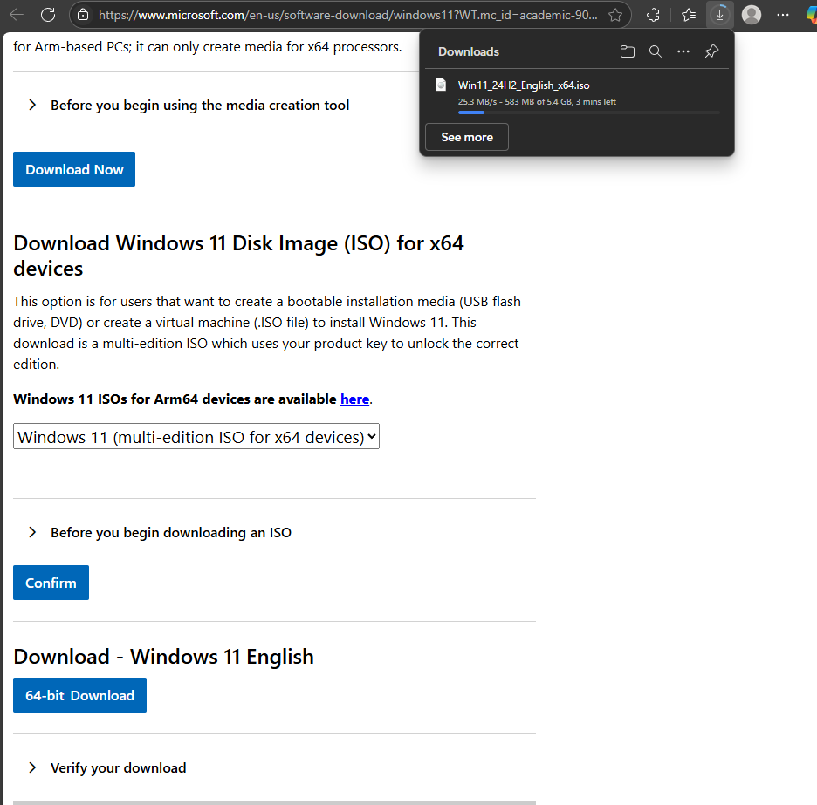
Download ISO

Slide 3
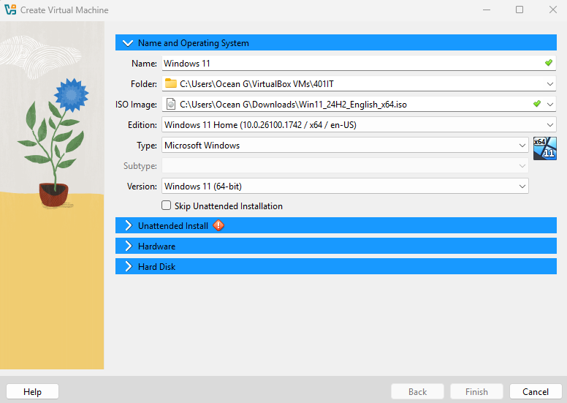
Begin setup for vm creation
Name
Iso
File location

Slide 4
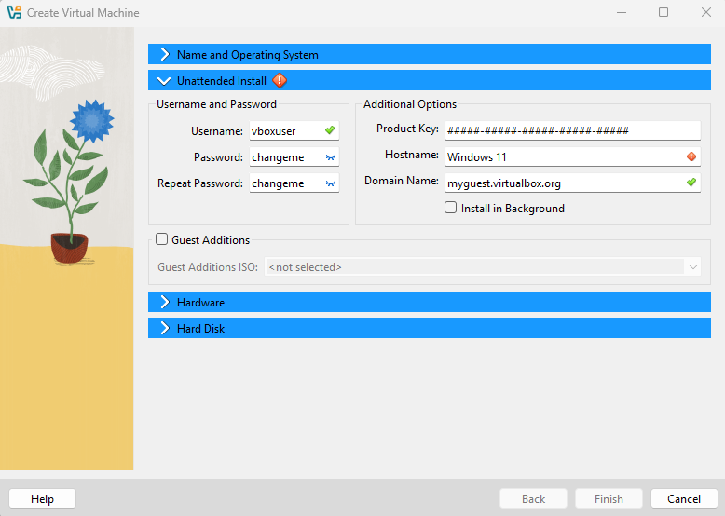
Set password and user

Slide 5
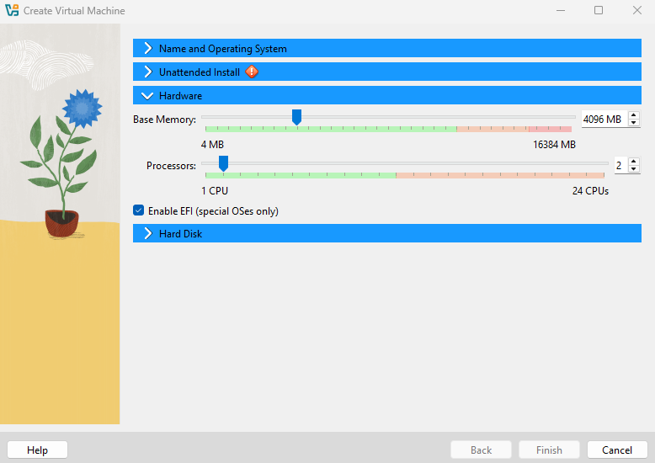
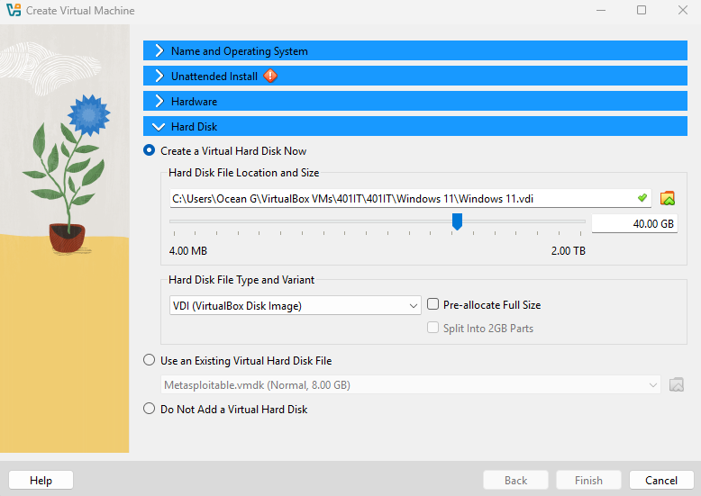
Define resources
Finish creation

Slide 6
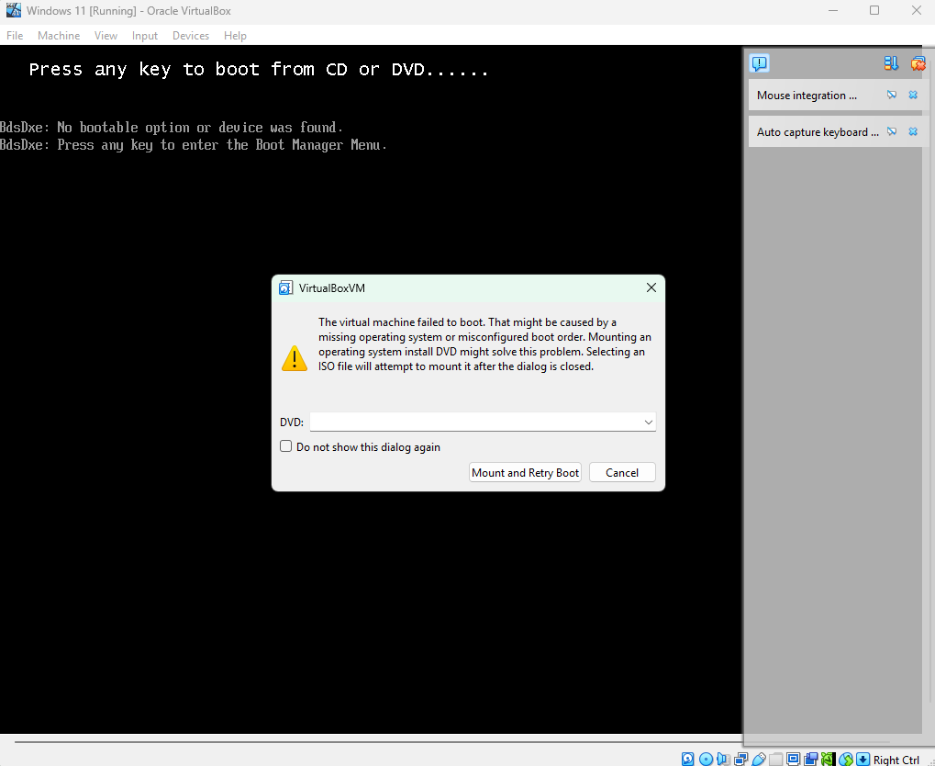
Error
Going into boot
Or using esc during boot.

Slide 7
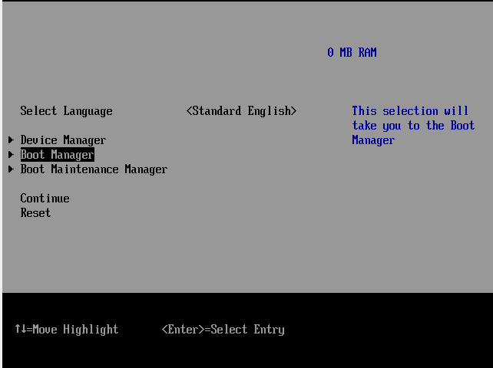
Going into the boot manager and selecting the CD-ROM can get the system to open, however on shutdown of system the issue reappears

Slide 8
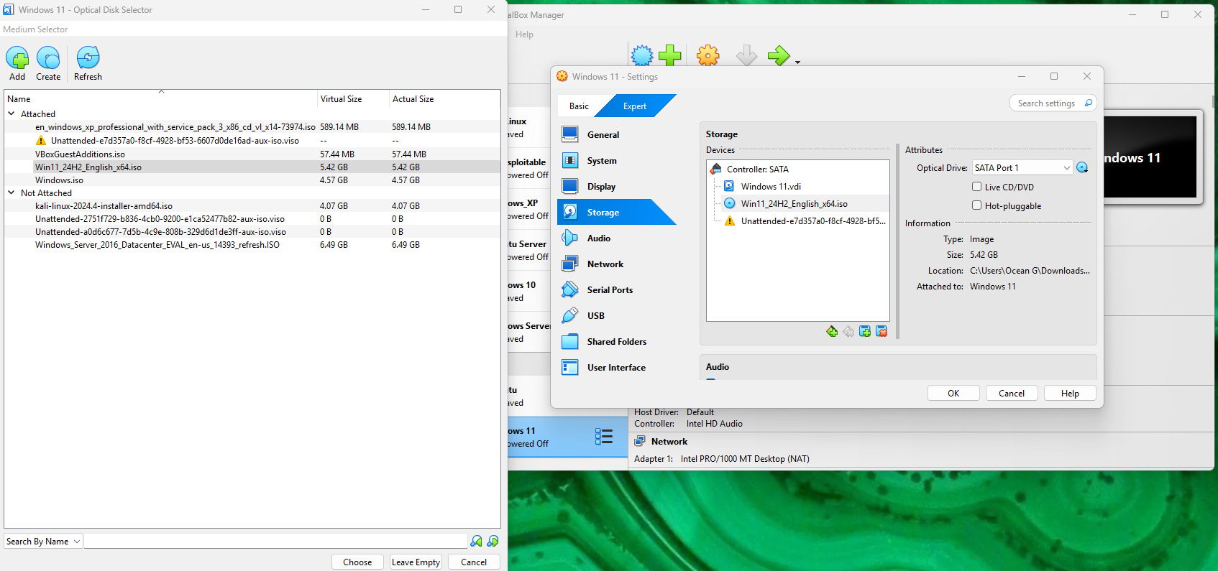
Attempt to attach windows 11 iso to optical drive as well as remove unattended file
unsuccessful

Slide 9
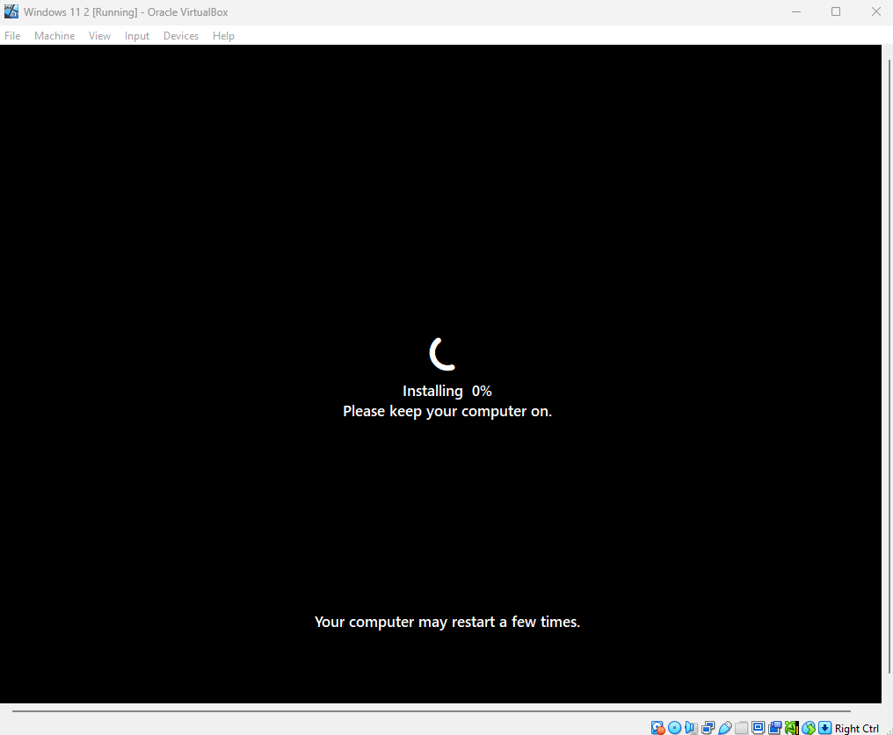
A alternate version of windows 11 was installed witg different settings which resolved the problems of the original
(double the Hard Disk memory)

Slide 10
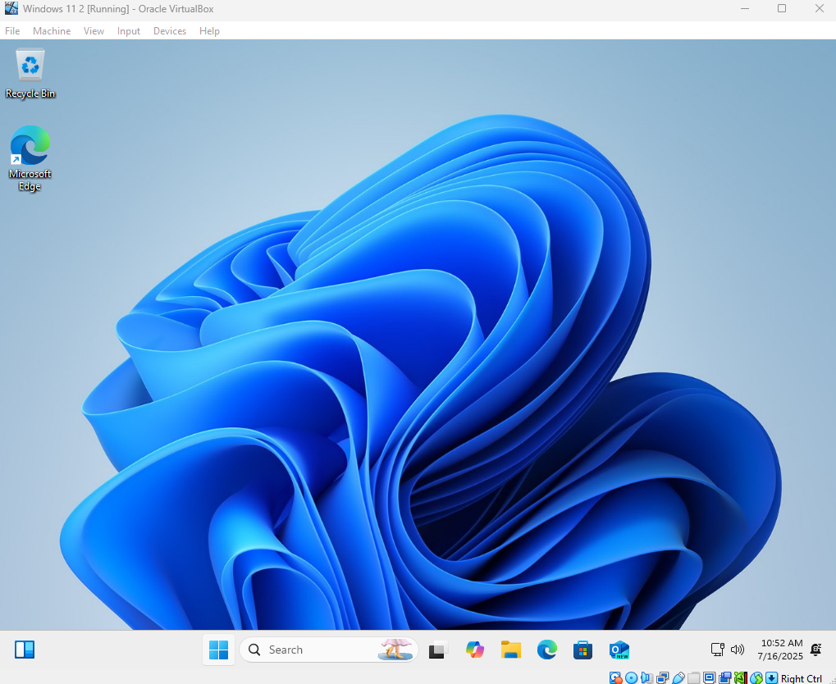
Successful installation

